Slide 1
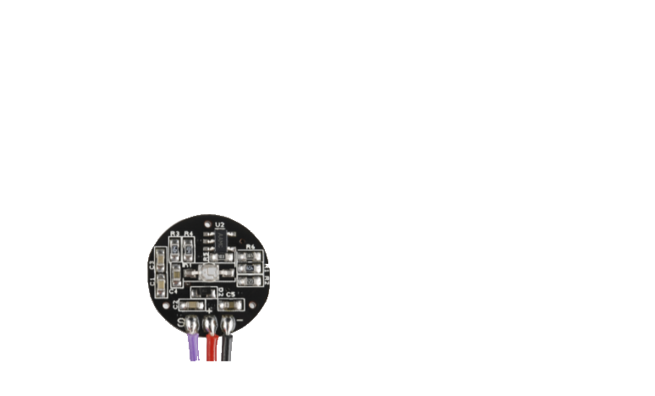
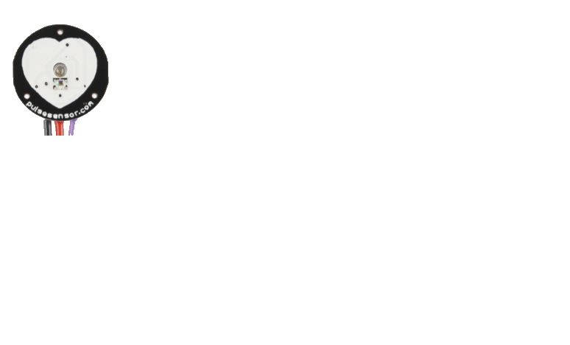

Slide 2
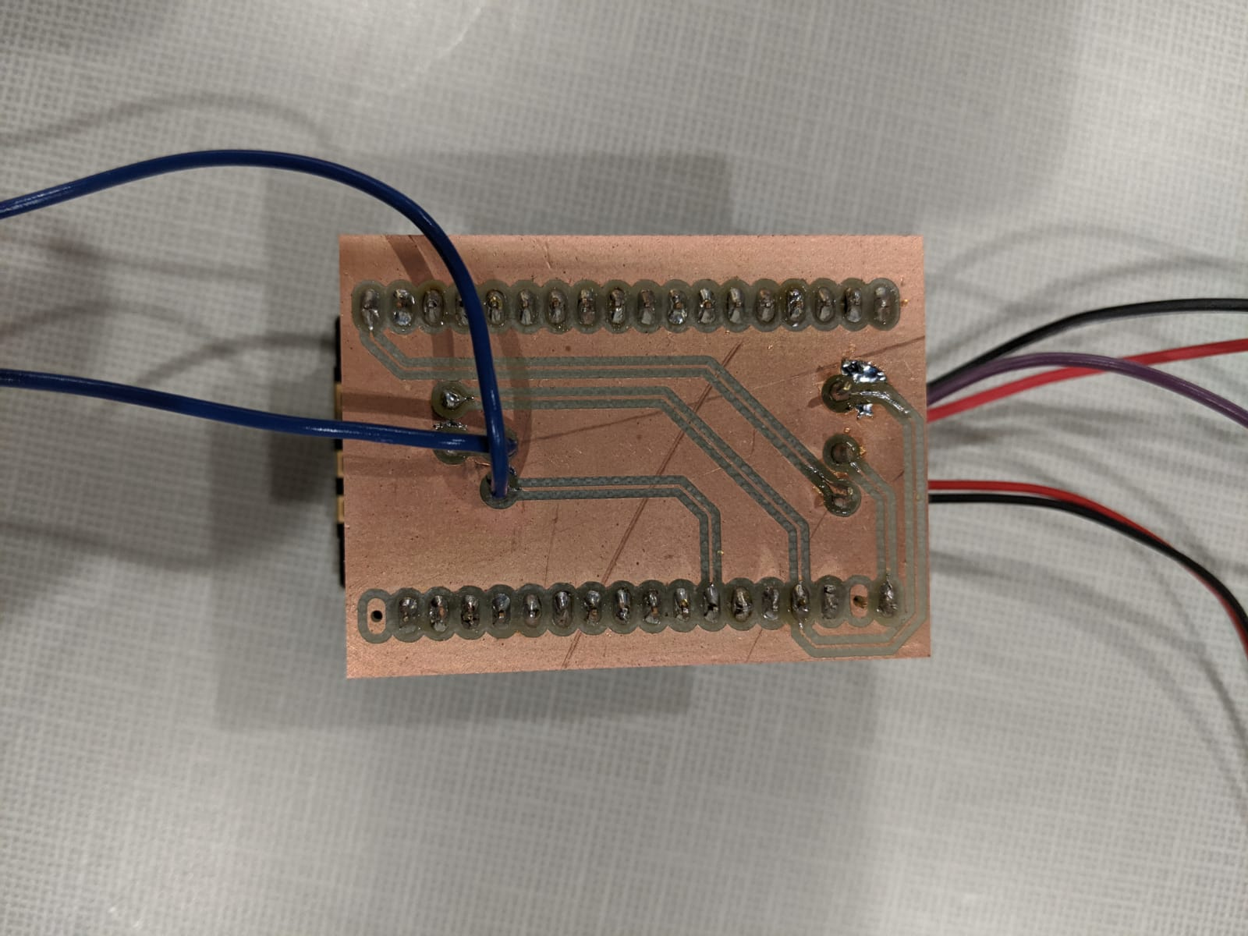
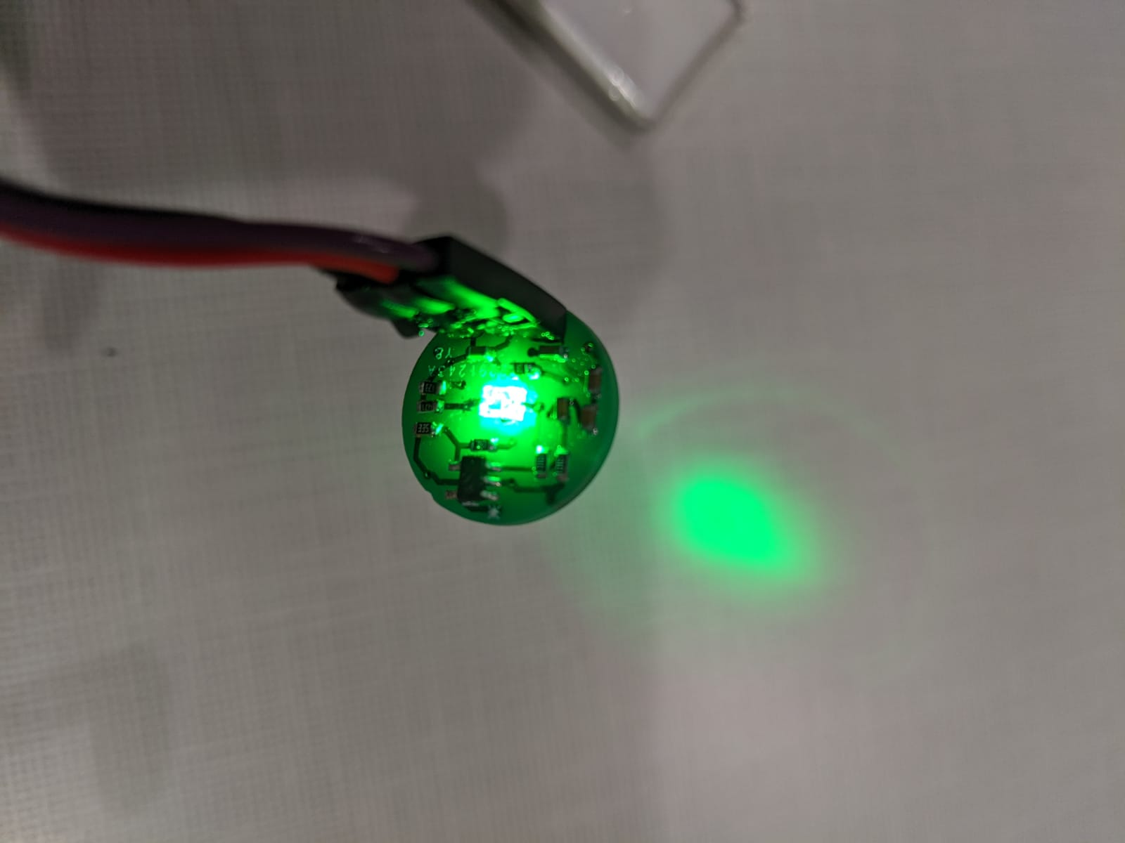
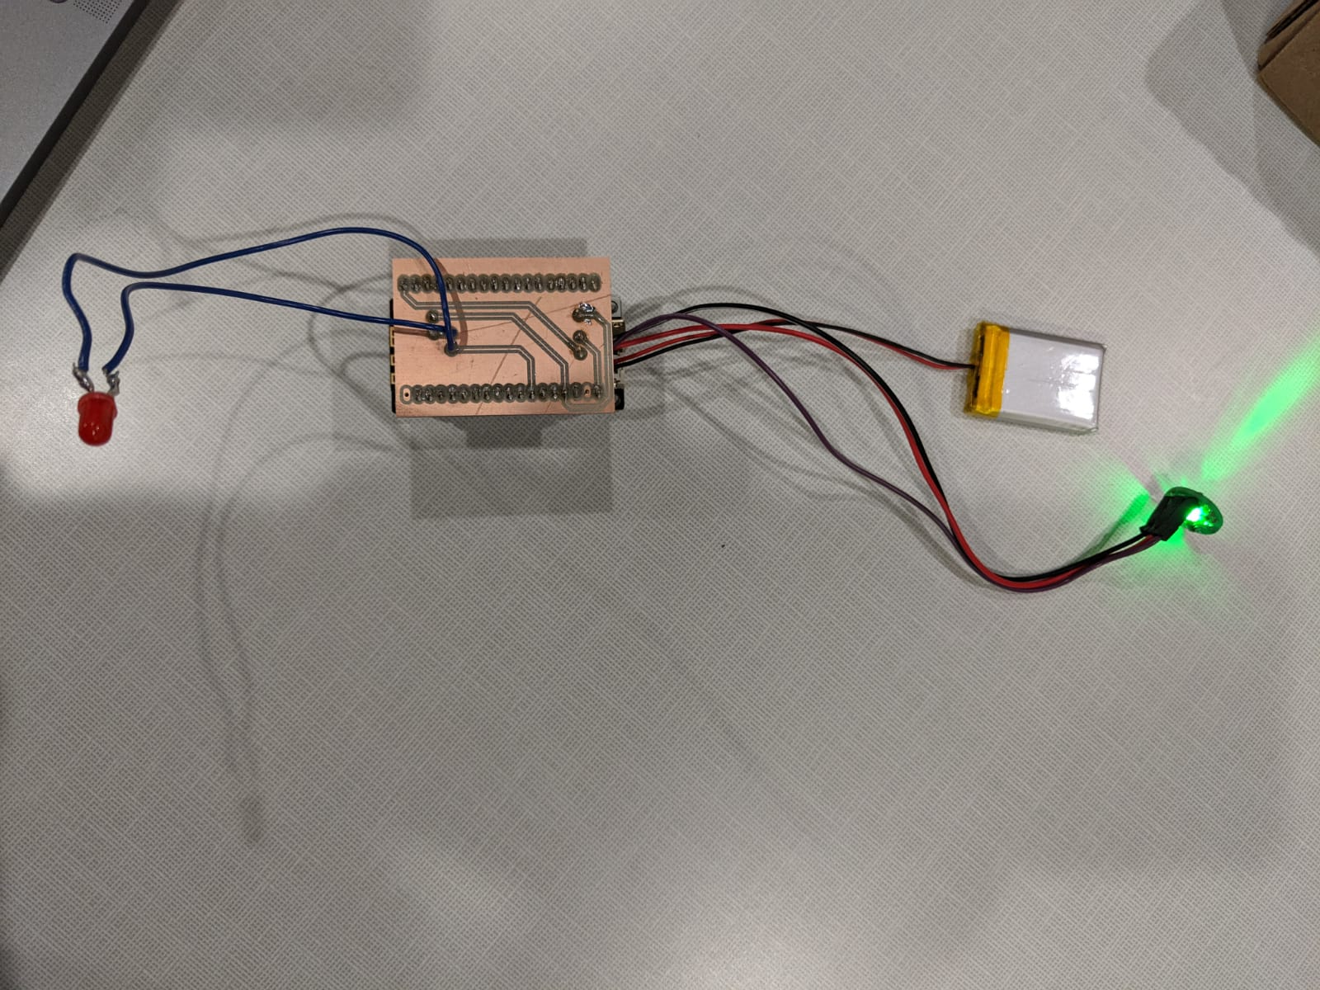
Prototyping
Text
Text
Text

Slide 3
Signal Acquisition
Receive BPM from the device via Arduino

Slide 4
Computations
Heart Rate computation and Time between beats

Slide 5
Poincare Plot
To create the heartrate variability

Slide 6
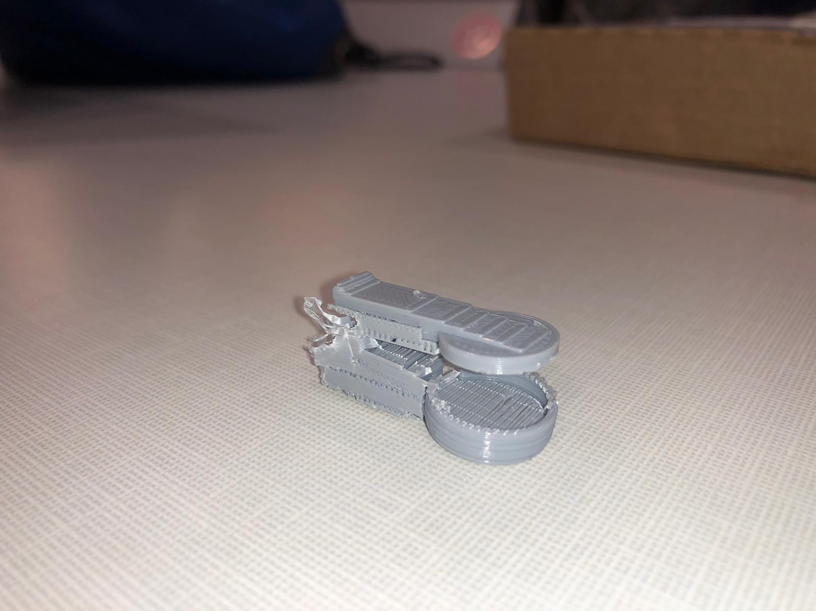
Final Device
Housing of the device

Slide 7
QUESTIONS
College of Name | Department of Name

